Slide 1
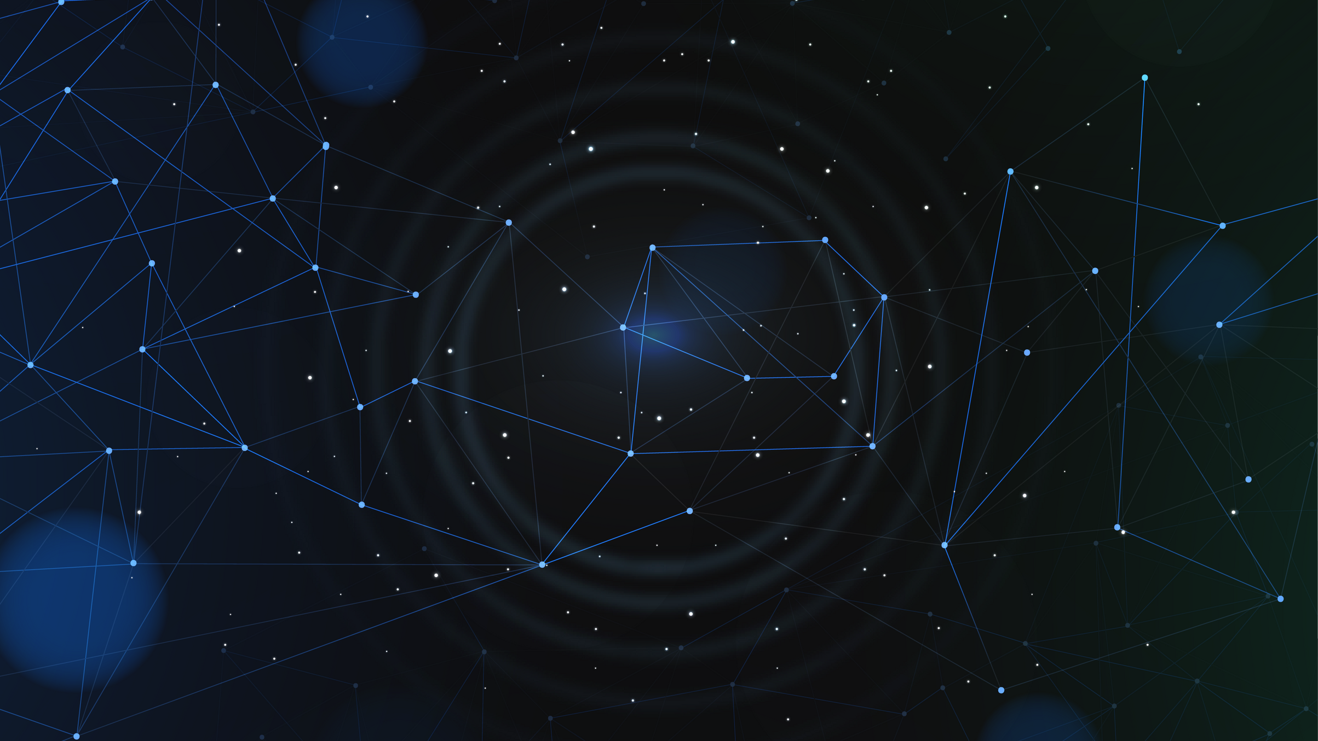
Automatic Music Generation Using Transformers

Slide 2

Automatic Music Generation Using Transformers
Automatic music generation using transformers is a cutting-edge AI technique that employs transformer models to compose music without human intervention.
These models analyze vast music datasets and user input, such as genre, to generate original music compositions making it a valuable tool for various applications.

Slide 3
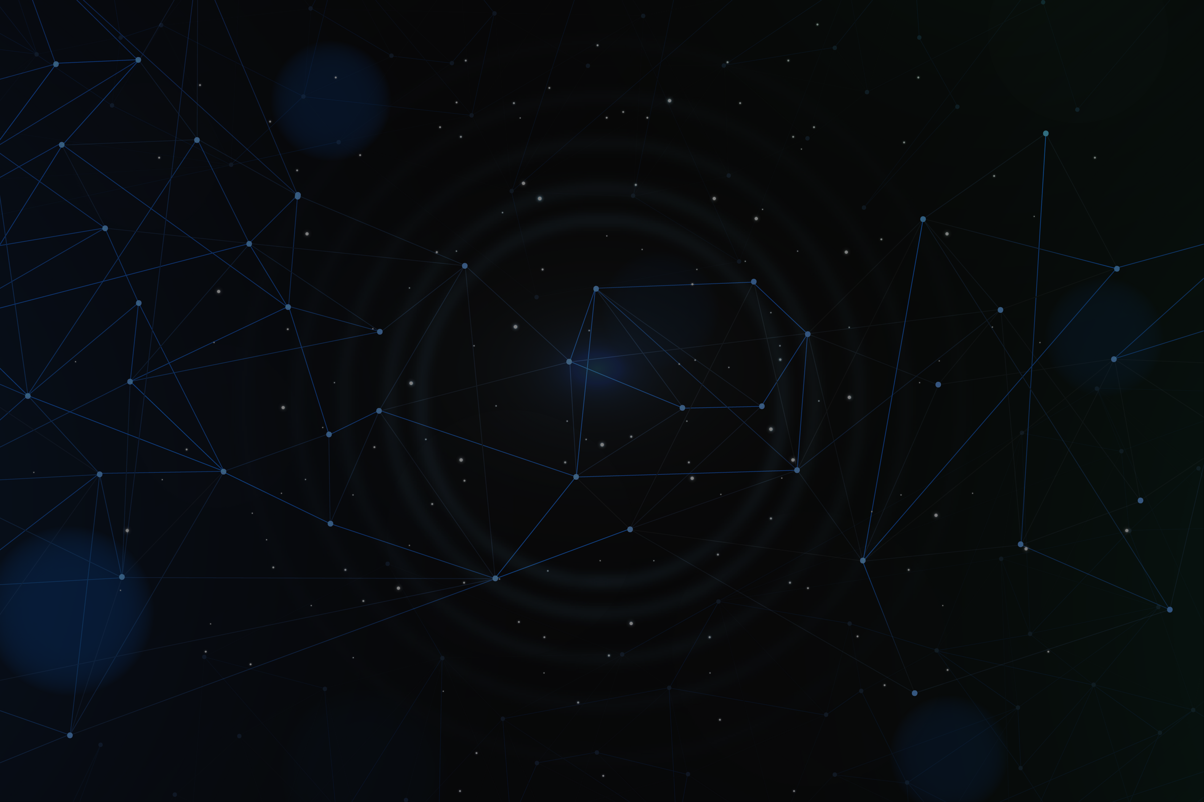

Automatic Music Generation
Definition:
Automated music composition is the use of AI or computer programs to create music without human involvement.
AI's Role:
AI's role in music creation encompasses machine learning techniques that enable the generation, analysis, and manipulation of musical content, enhancing the creative process

Slide 4
Flowchart
Take input in the form of video and genre of music
Remove the base audio from the video
Generate Music through transformer
Final Output
Add music to the video
Model will output music on basis of the prompt

Slide 5
Benefits and Application
Cost effective manner of generating music for any application.
AI generated music will always be royalty-free.
Main application will be in content creation, gaming and advertising.

Slide 6
Functional requirements
Build a react app for the project
User can upload a video max 10mb
We are going to take input from user on what genre they want to AI to generate the music (3-5 genre)
Output video can be viewed on-website and if the user is satisfied with the music they can download the music

Slide 7
Non-Functional requirements
Rate limit user to safe guard the system from multiple requests
The system should return the output within 2 minutes
Downtime for the system should be less than 5 minutes a day

Slide 8
Future Scope
The system should generate music with multiple instruments and have a perfect sync
The system give the user all possible genre to select from
The system should generate music within 30 seconds
The website should have a build-in synthesizer and a mixer to balance, and combine different sounds from different audio signals.

Slide 9
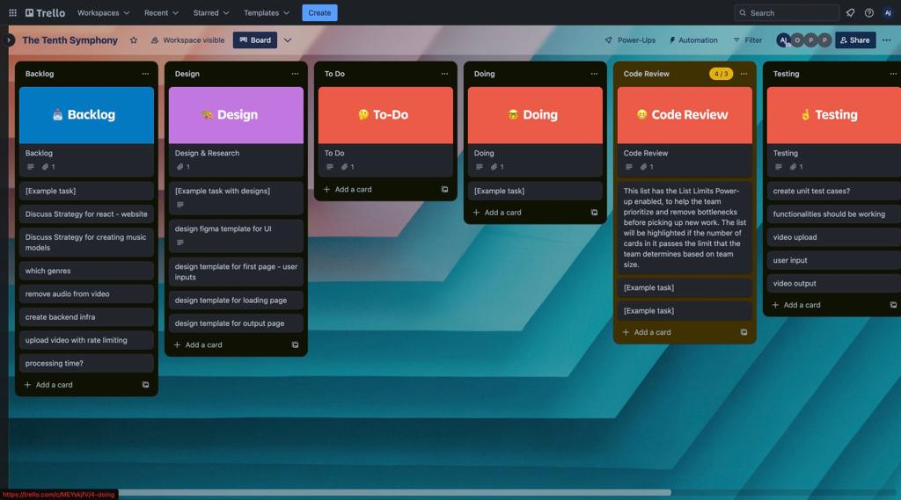
Sprint Planning
We will be using Trello to manage our tasks.

Slide 10
Reference Links
https://paperswithcode.com/datasets?task=music-generation
https://musicautobot.com/song/c8bcf08c8d31c98c61a91b2d90a9cdde

Slide 11
THANK YOU!

